Slide 1


Adaptation of an invasive mosquito to growing seasons across multiple geographic scales
Sasha Mushegian, Naresh Neupane, Zach Batz, Moto Mogi, Nobuko Tuno,
Leslie Ries, Peter Armbruster

Slide 2
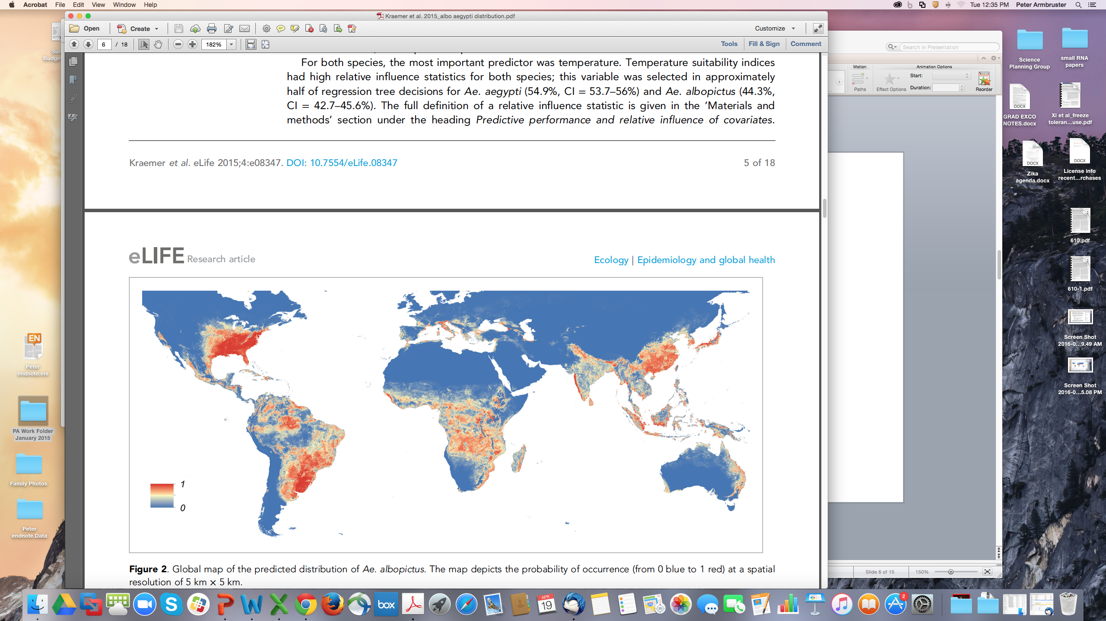
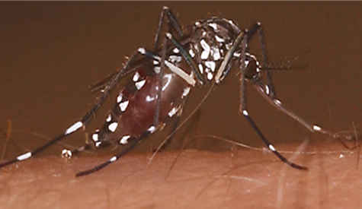
Invasion and Range Expansion of Aedes albopictus
Highly invasive
Aggressive human biter
Vector (dengue, chikungunya)
Adapted to both tropical and temperate climates
Aggressive biter; vector of CHIKV, DENGV
Present in USA since 1985
Probability of occurrence
Kraemer et al. 2015

Slide 3
What accounts for the rapid establishment of Ae. albopictus in diverse worldwide habitats?
What is its capacity for continual spread and local adaptation under ongoing climate change?

Slide 4
Photoperiodic Diapause
A key adaptation: Photoperiodic diapause
Developing
Long-day
Short-day
Diapausing
Notes:
For the invasive mosquito Aedes albopictus, pupal and adult females are photoperiodically sensitive and produce diapausing eggs under the influence of short days.

Slide 5
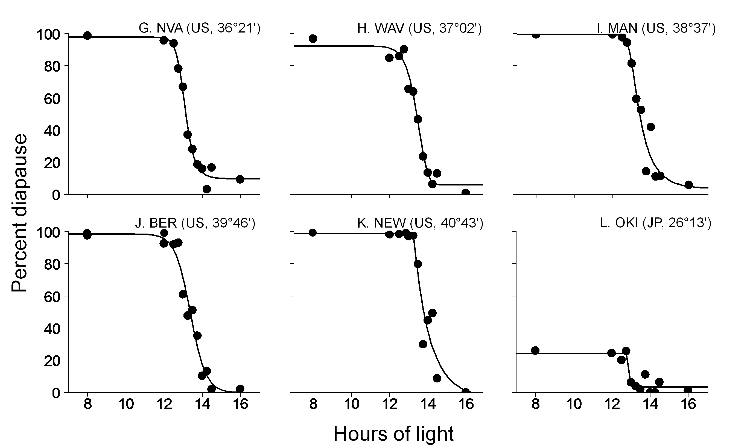
Variation in diapause incidence and diapause timing
Diapause incidence: % diapausing eggs at 8 h light (unambiguous short day)
Low/no diapause in tropical populations
Critical photoperiod: Day length at which 50% of eggs are in diapause
Represents diapause timing in field

Slide 6
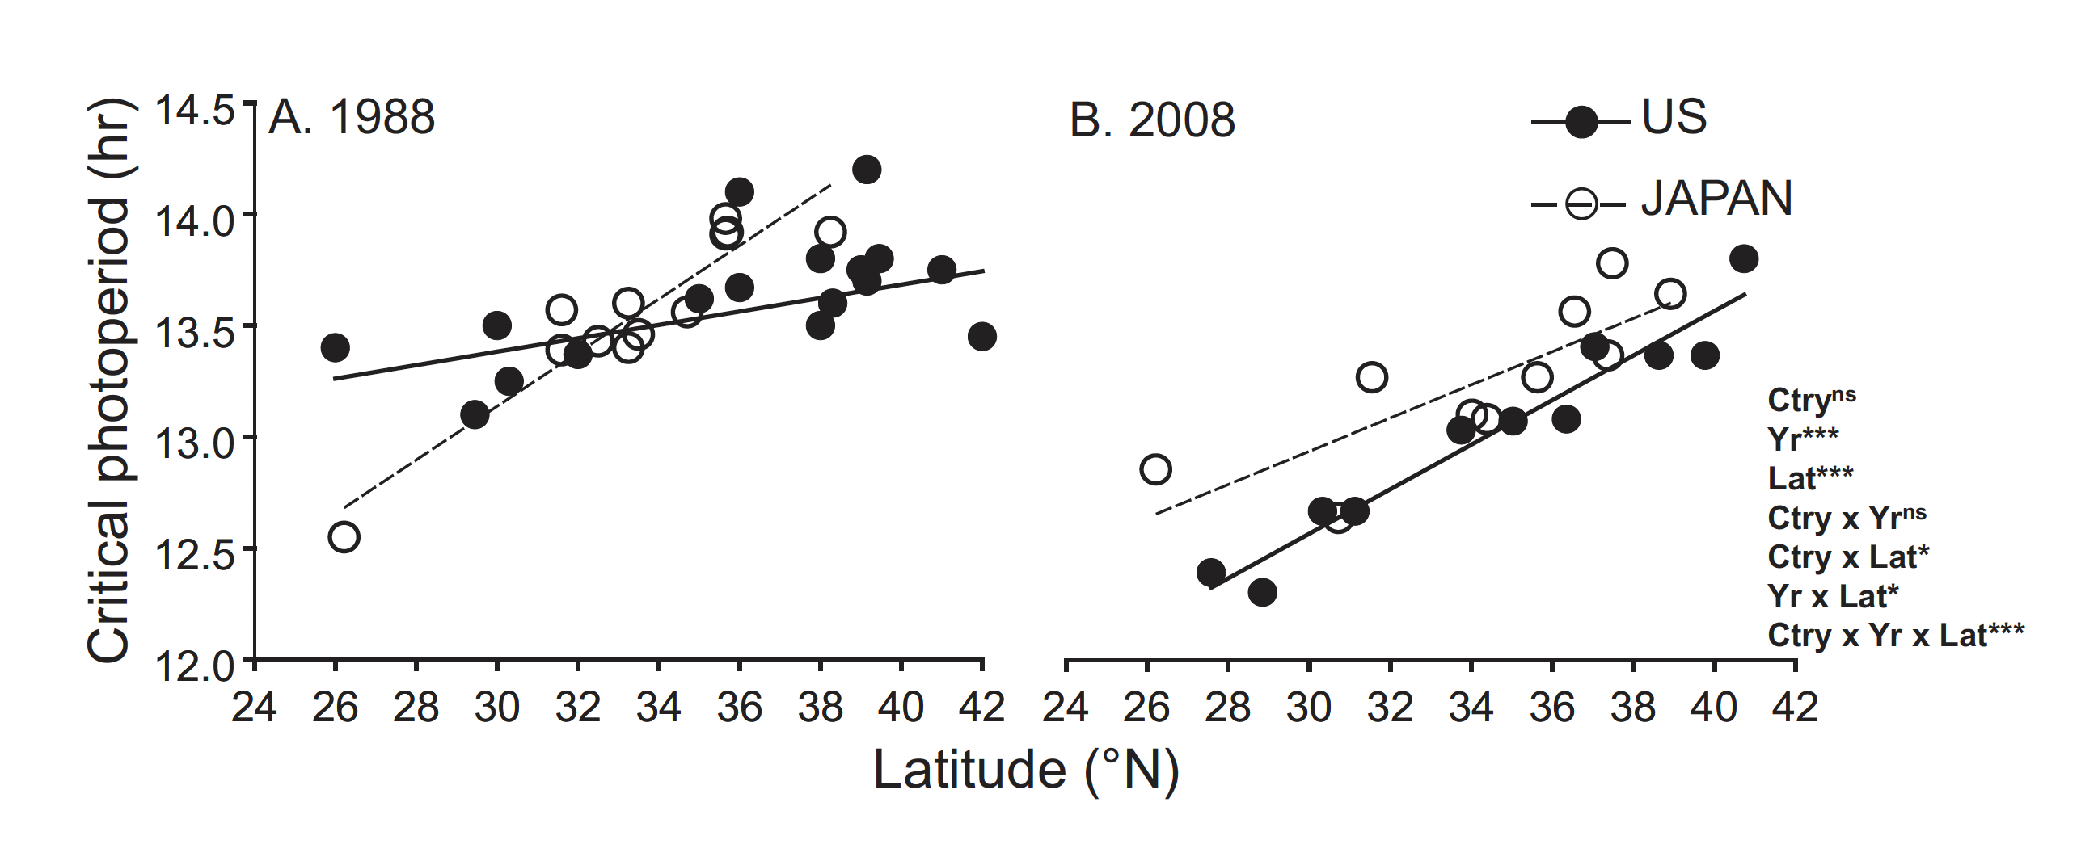
Previously: Evolution of latitudinal clines in Aedes albopictus overwintering diapause
Urbanski et al Am Nat 2012:
Ae. albopictus quickly established a latitudinal gradient in timing of overwintering diapause in the eastern USA.
What has happened in the last 10 years?

Slide 7
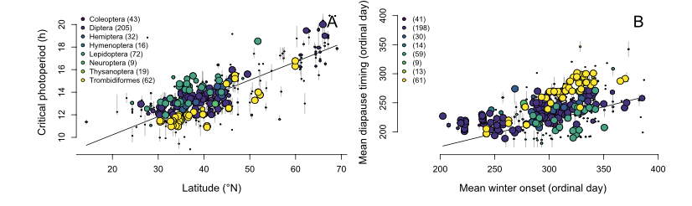
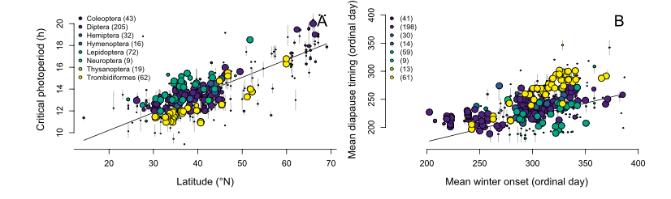
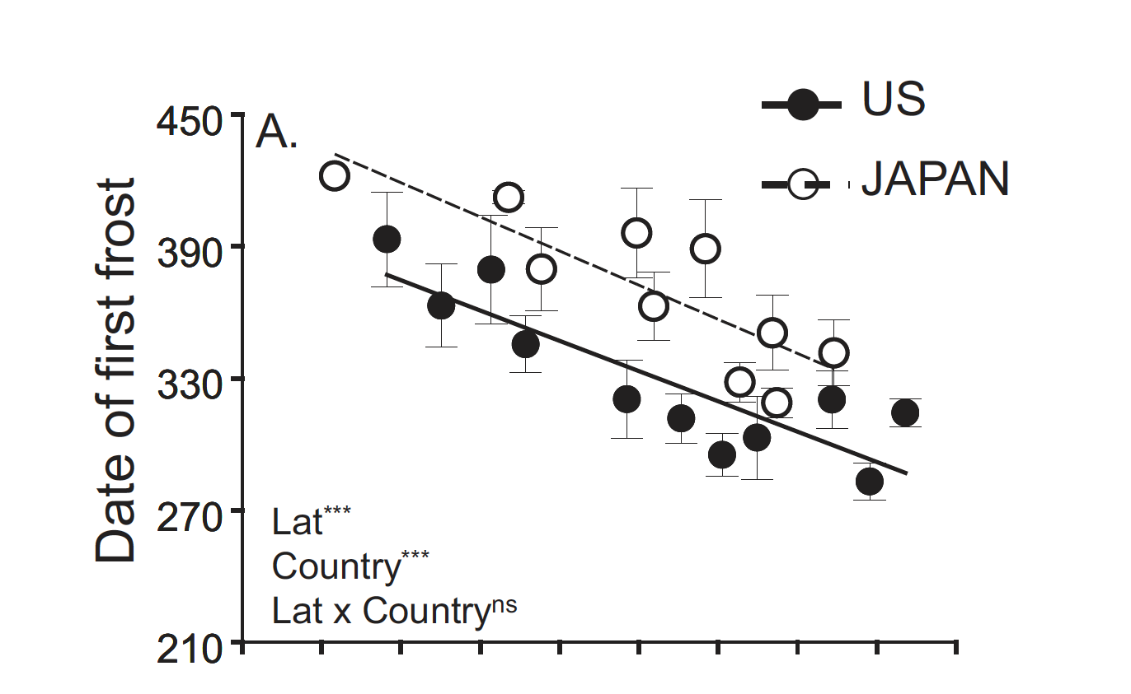
Which environmental factors drive establishment of latitudinal clines in diapause?
Joschinski and Bonte, bioRxiv 2020
Urbanski et al Am Nat 2012

Slide 8
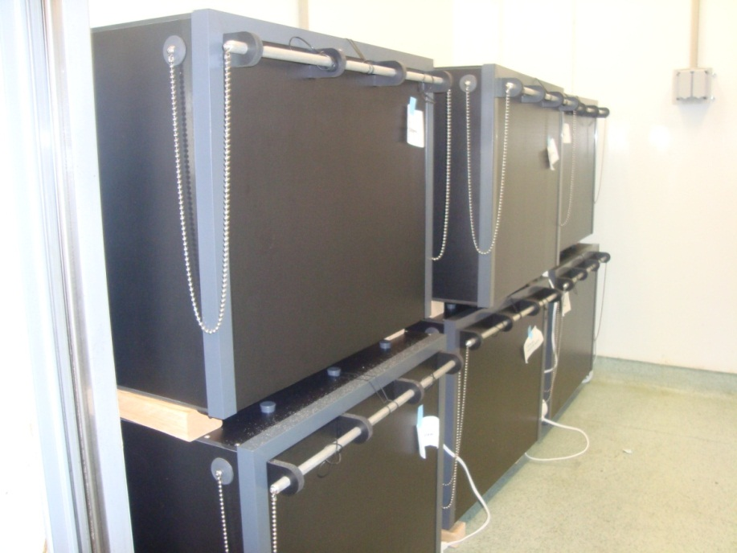

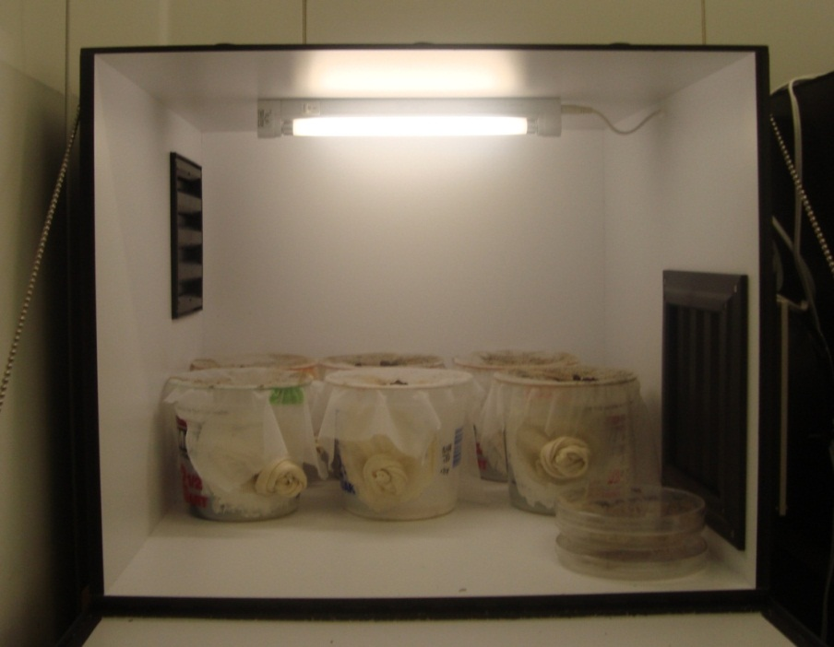
Replication of latitudinal clines across space and time: Experimental design
Collected from the same range of latitudes in the native (Japan) and introduced (US) range of Ae. albopictus
Many locations same as in 2008
Raised in lab for 3-4 generations
Starting from pupal stage, exposed to a range of photoperiods; % eggs in diapause at each photoperiod calculated
Hours light
8
12
12.5
12.75
13
13.25
13.5
13.75
14
14.25
14.5
16
Hours dark
16
12
11.5
11.25
11
10.75
10.5
10.25
10
9.75
9.5
8

Slide 9
Diapause incidence across sampling range
Completely diapausing populations north of ~32 degrees N
Diapause incidence has not changed significantly since 2008.

Slide 10
Critical photoperiod increases with latitude in US and Japan
 | F value | Pr(>F)
latitude | 268.479 | <0.001 | ***
country | 35.801 | <0.001 | ***
year | 22.405 | <0.001 | ***
lat:country | 1.849 | 0.183
lat:year | 1.955 | 0.171
country:year | 0.354 | 0.556
lat:country:year | 0.412 | 0.525

Slide 11
Critical photoperiod increases with latitude in both the native and introduced range of Aedes albopictus.
Slope of clines unchanged since 2008
Latitude-specific critical photoperiods suggest that diapause entry is earlier in Japan compared to the US.
Consistent continent-scale difference
How is diapause timing optimized?

Slide 12
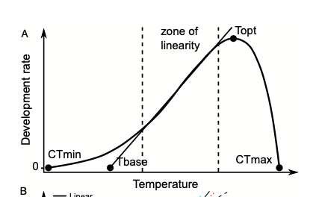
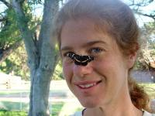
Predicting optimal diapause timing using growing degree days (GDD)?
GDD models widely used in agriculture for plant/pest phenology
Temperature-dependent development rates = life cycle requires accumulation of degree-days
Optimal diapause date can be no later than time required to complete another generation under specific temperature conditions
Leslie Ries

Slide 13
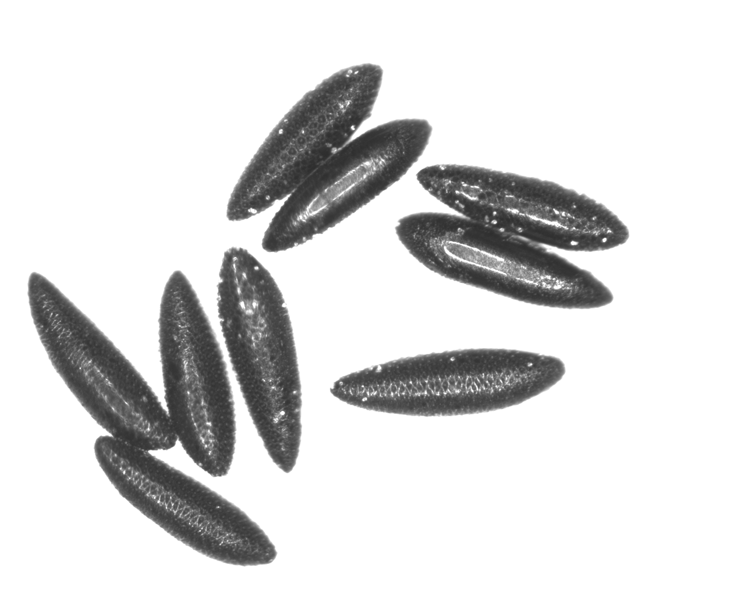
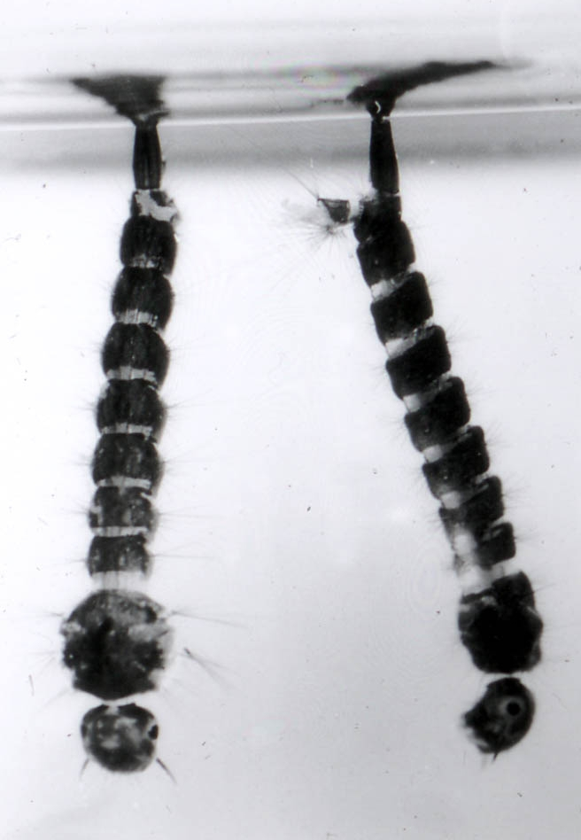
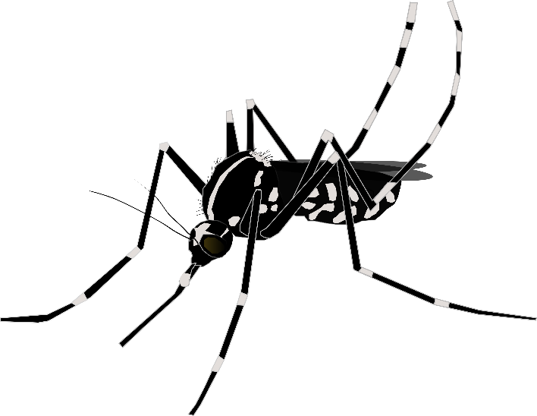

Deadline Day
From published literature: an Ae. albopictus generation (from egg to oviposition) requires ~400 growing degree days.
Use this to calculate a ”deadline day” for each location based on temperature records for each year.
400 GDD remaining in season
TEMPERATURE
10 C
summer
winter
DAY
Naresh Neupane

Slide 14
Corroborating GDD deadline with field data

Slide 15
GDD deadline consistently earlier in Japan

Slide 16
GDD deadline predicts CPP across continents
gdd400 | <0.001 | ***
country | 0.622
gdd400:country | 0.071 | .
gdd400 | <0.001 | ***
country | 0.232
gdd400:country | 0.028 | *
gdd400 | <0.001 | ***
country | 0.212
gdd400:country | 0.066 | .
gdd400_mean | <0.001 | ***
country | 0.257
gdd400_mean:country | 0.33

Slide 17
Conclusions and further questions
Ae. albopictus CPP shows robust latitudinal gradient with consistent shift between native and invasive range
Ae. albopictus diapause timing is optimized to generation times allowed by local conditions; has been so since 2008
GDD deadline prediction incorporates more climatic information (growth rates, local temporal weather patterns)
Parallels between rapid adaptation of invasive species and adaptation under climate change – can we make better predictions? (Phenological mismatch, disease risk, etc?)

Slide 18
Acknowledgements
Armbruster Lab
Peter Armbruster
Zach Batz
Mara Heilig
Kaitlin Reynolds
Jack Boyle
Funding: NIH Award R01 AI132409-01
Ries Lab
Leslie Ries
Naresh Neupane
Mariana Abarca Zama
Thank you!!

